Slide 1
Using Deep Learning To Implement Domain Generation Algorithm
Student: Chia-Ruei Lee
Advisor: Chia-Mu Yu

Slide 2
目錄
A. Introduction
1. Botnet
2. Domain Generation Algorithm
B. Deep Learning
1. Neural Network
2. Auto-Encoder
3. Generative Adversarial Networks (GAN)
4. Wasserstein GAN (WGAN)
5. Improved Wasserstein GAN
C. Using GAN To Implement DGA

Slide 3
Botnet
Introduction

Slide 5
Domain Generation Algorithm
Introduction

Slide 7
Neural Network
Deep Learning

Slide 9
Auto-Encoder
Deep Learning

Slide 11
Generative Adversarial Networks (GAN)
Deep Learning

Slide 12
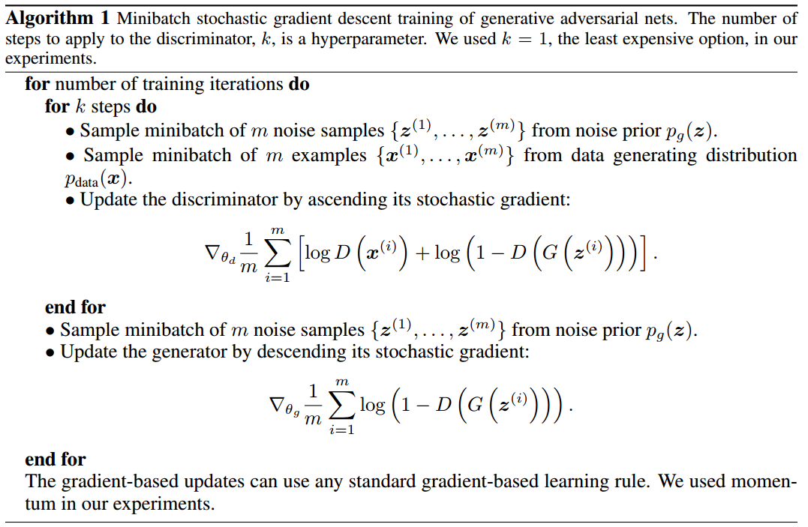
Algorithm
From “Generative Adversarial Networks”
https://arxiv.org/abs/1406.2661

Slide 13
Wasserstein GAN (WGAN)
Deep Learning

Slide 14
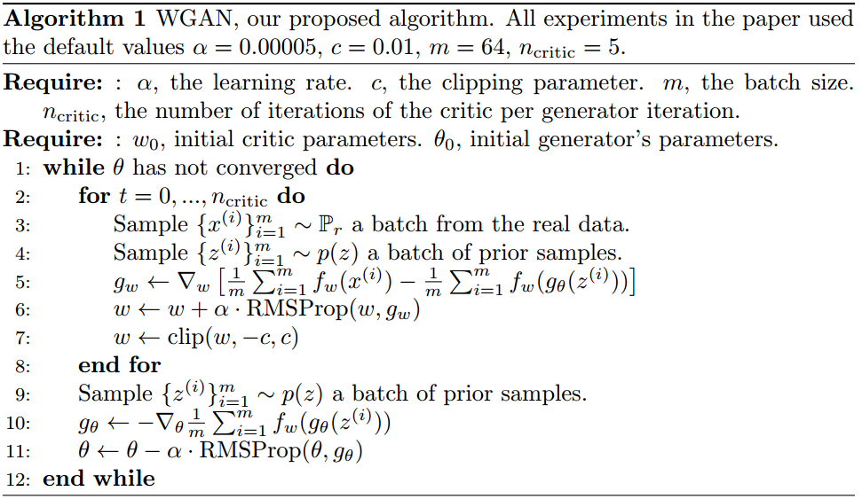
Algorithm
From “Wasserstein GAN”
https://arxiv.org/abs/1701.07875

Slide 15
Improved Wasserstein GAN (WGAN-GP)
Deep Learning

Slide 16
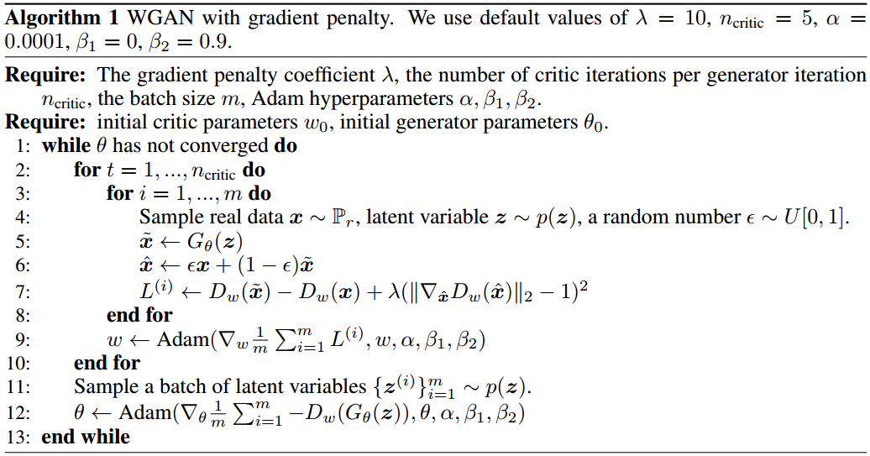
Algorithm
From “Improved Training of Wasserstein GANs”
https://arxiv.org/abs/1704.00028

Slide 17
Using GAN To Implement DGA

Slide 18
Algorithm

